Slide 1

STROKE PREDICTION DATASET
MILENE CARMES VALLEJO​​

Slide 2
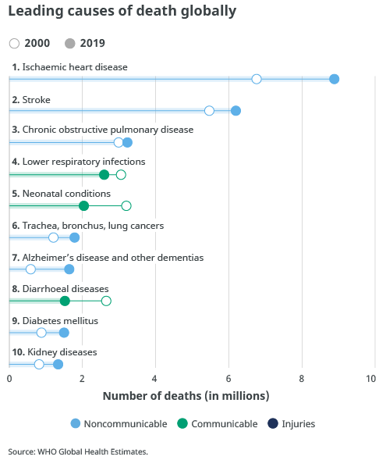

Stroke facts
Is the second leading cause of death globally, responsible for approximately 11% of total deaths
Every 40 seconds, someone in the United States has a stroke (CDC).
Every 3.5 minutes, someone dies of stroke (CDC).
Stroke is a leading cause of serious long-term disability (CDC)

Slide 3
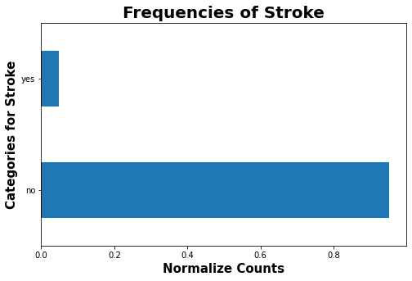
Project Description
DATA SOURSE
Kaggle​
UNBALANCED TARGET
DATA DESCRIPTION
The data contains 5110 observations of patients​
95% of patients didn't have a stroke and 5% had
ATTRIBUTES
1) id
2) gender
3) age
4) Hypertension
5) heart_disease
6) ever_married
7) work_type
8) Residence_type
9) avg_glucose_level
10) Bmi
11) smoking_status
12) stroke – target

Slide 4
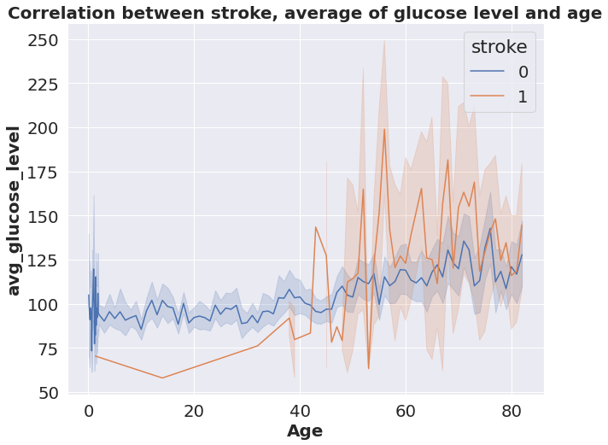
Do age and glucose level have an impact on strokes?
Yes
Patients who had a stroke (1) are older than 40 years old and have higher glucose levels than patients who didn't have a stroke (0).

Slide 5
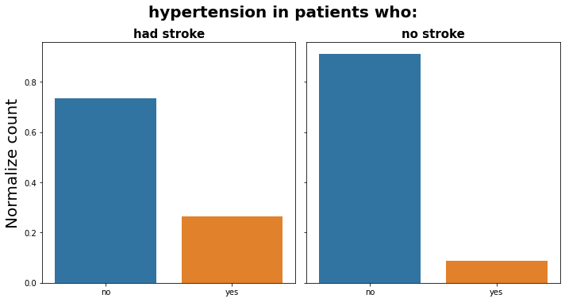
Does hypertension have an impact on strokes?
Yes
Patients who had stroke about 25% have hypertension.
Patients who didn’t have stroke less than 10 % have hypertension.
25%
10%

Slide 6
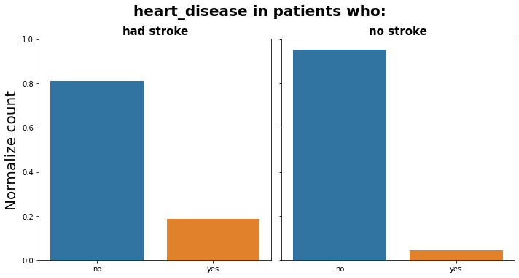
Does heart disease have an impact on strokes?
Yes
Patients who had stroke about 20% have heart disease.
Patients who didn’t have stroke less than 5% have heart disease.
20%
5%

Slide 7
Machine Learning Models: Goal
PREDICTION OF STROKES
Early action is important for stroke - the chances of survival are greater when emergency treatment begins quickly
Since this prediction is to diagnose stroke the best model is the one with a lower false-negative rate and higher accuracy.

Slide 8
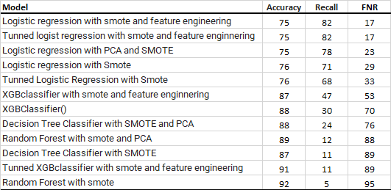
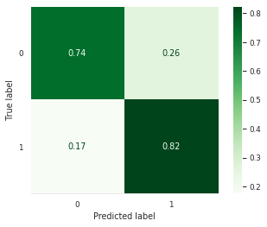
Classification models
TEST MODELS
BEST MODEL :
LOGISTIC REGRESSION

Slide 9
Recommendations
Patients older than 40 years old, with high glucose levels or/and hypertension or/and heart disease have higher risk to have a stroke.
So is better to monitor for stroke symptoms and seek help in case of any symptom.

Slide 10
THANK YOU
FOR ANY ADDITIONAL QUESTIONS, PLEASE CONTACT
MILENE.C.VALLEJO@GMAIL.COM

